Slide 1
Roundtable Final Project Creative Coding
HEEJIN JANG

Slide 2
INDEX
Puzzle
Arrow Game
Falling Objects

Slide 3
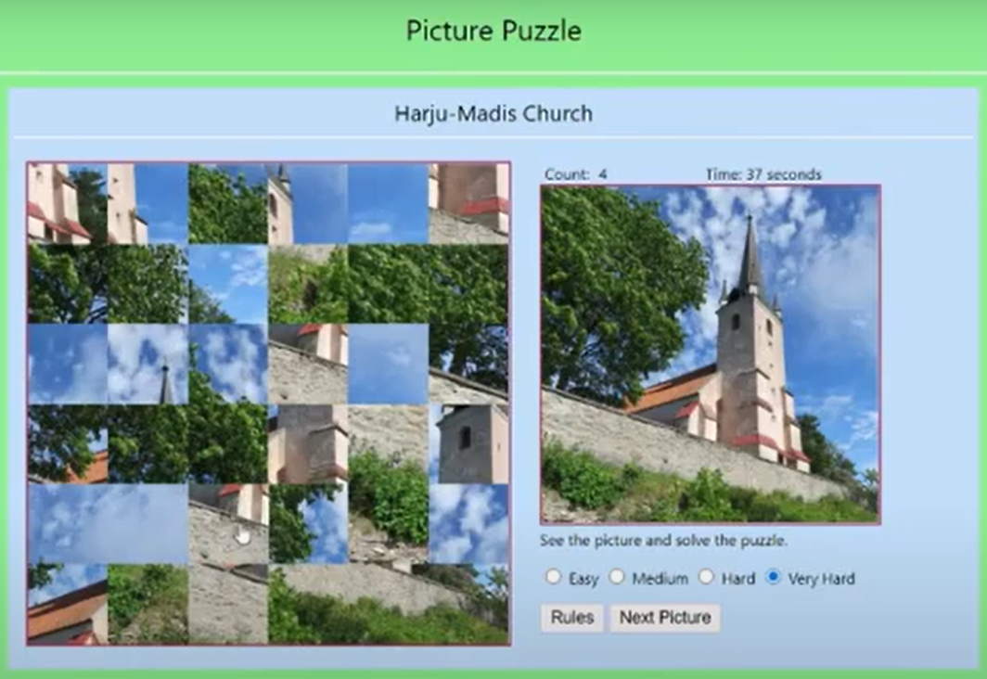
Puzzle
A puzzle game that shuffles images
Images: current event or social issues
Puzzle
Arrow Game
Falling Jewelries

Slide 4
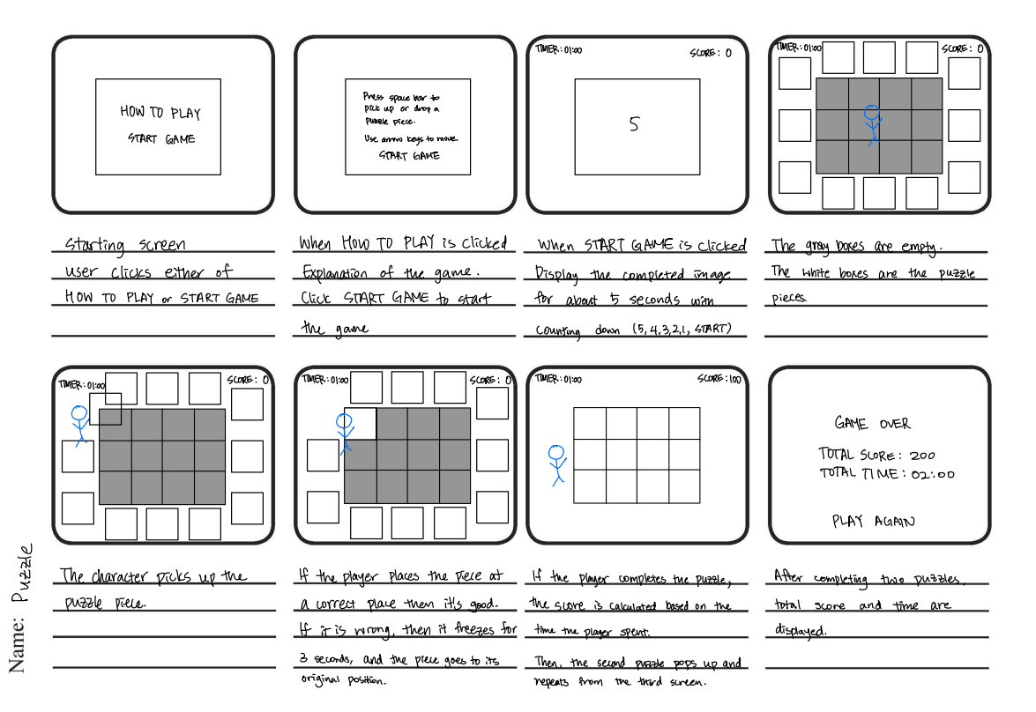
Puzzle
Puzzle
Arrow Game
Falling Jewelries

Slide 5
Puzzle
Puzzle
Arrow Game
Falling Jewelries

Slide 6
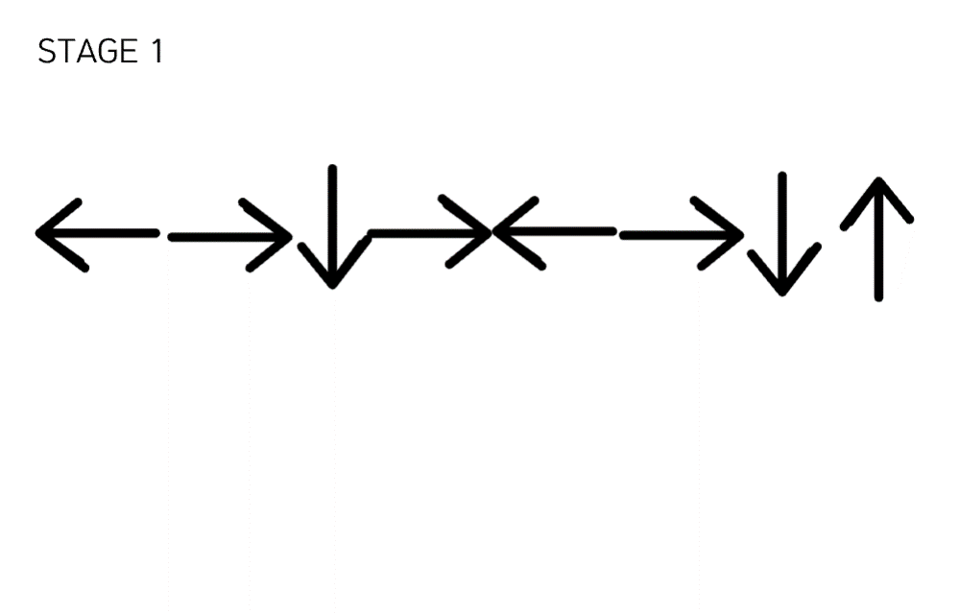
Arrow Game
Press arrow keys as shown on the screen
Total of 7 levels
Need to complete all levels before time runs out
Puzzle
Arrow Game
Falling Jewelries

Slide 7
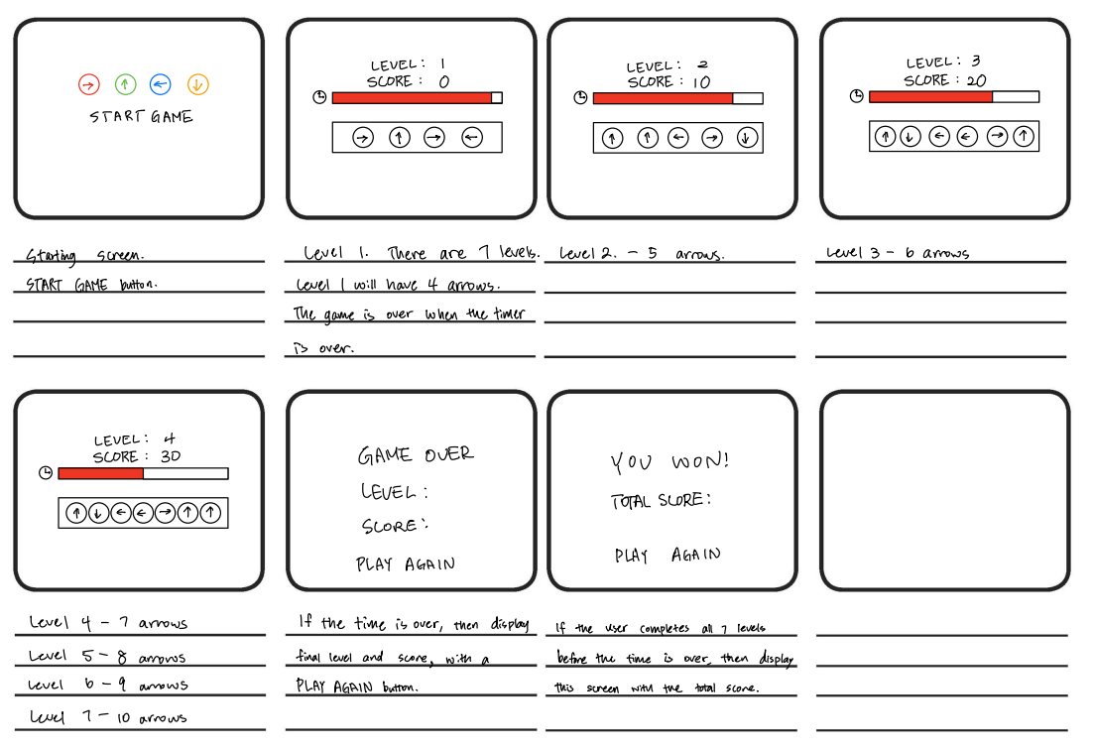
Arrow Game
Puzzle
Arrow Game
Falling Jewelries

Slide 8
Arrow Game
Puzzle
Arrow Game
Falling Jewelries

Slide 9
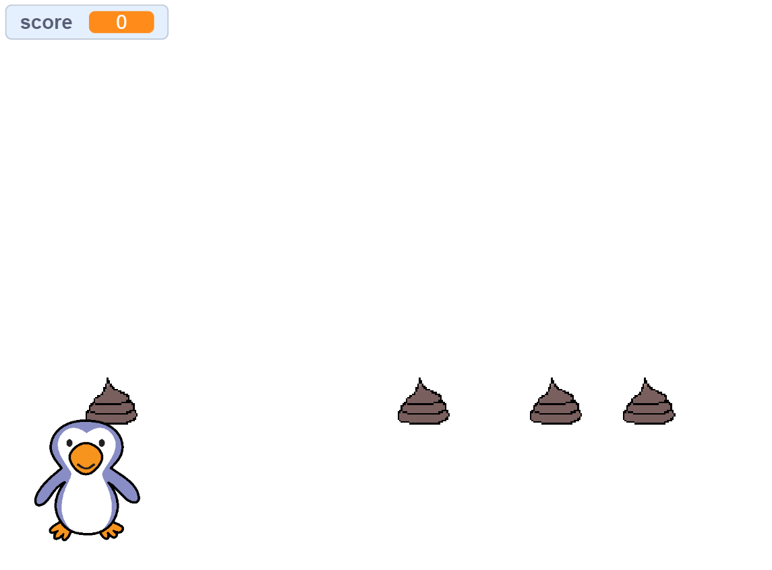
Falling Objects
Falling two different types of objects
Avoid one type of object
Catch another type of object
Puzzle
Arrow Game
Falling Jewelries

Slide 10
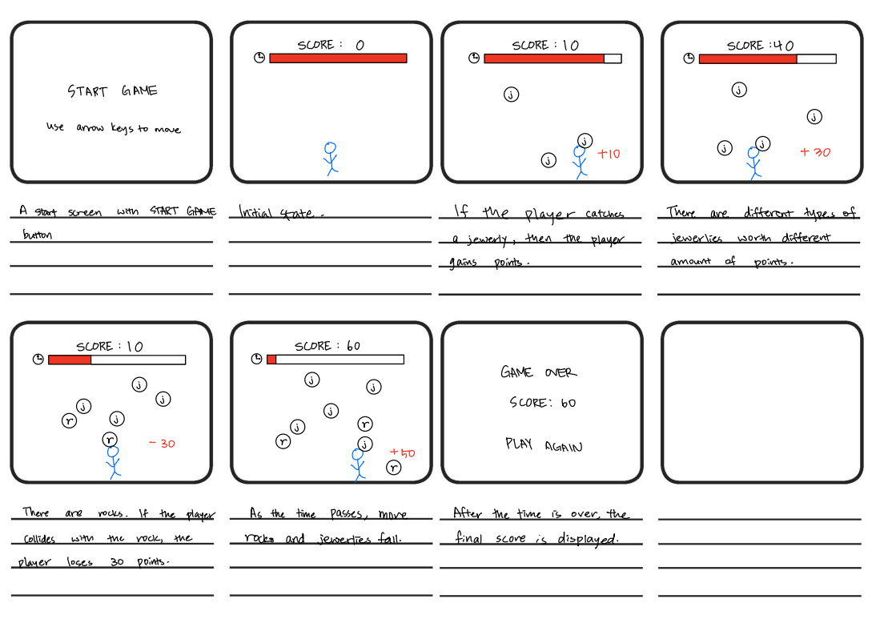
Falling Objects
Puzzle
Arrow Game
Falling Jewelries

Slide 11
Falling Objects
Puzzle
Arrow Game
Falling Jewelries

